Slide 1
Implementing a Hierarchy in SQL Server
Louis Davidson
drsql.org
Chief Nerd Officer

Slide 2
Implementing a Hierarchy in SQL Server
Louis Davidson (drsql.org)
drsql@hotmail.com

Slide 3

Who made this SQL Saturday possible?

Slide 4
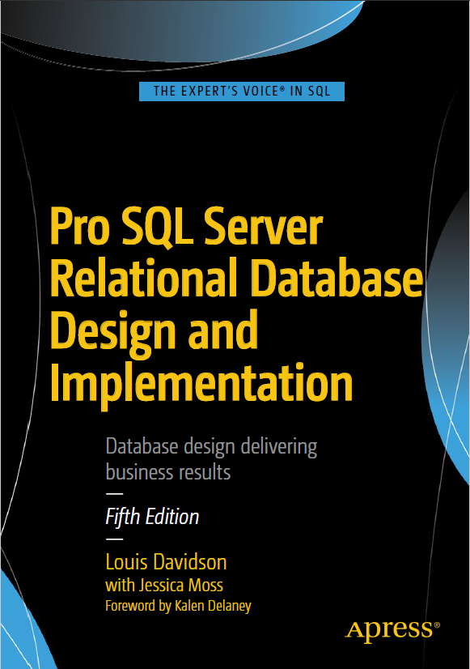
Who am I?
Been in IT for 20-some years
13 Microsoft MVP Awards
Corporate Data Architect
Written 6 books on database design
They were technically all versions of the same book.
Always new AND improved!
They had slightly different titles each time, but (probably) never again!
Super Brief Contact Info: DRSQL
Twitter, Website (.org), Email (@hotmail.com)
Notes:
Change it to planning the next version

Slide 5
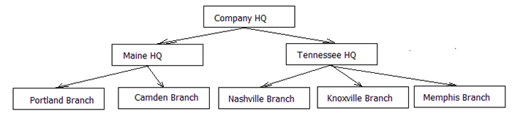
Hierarchy Classes
Trees - Single Parent Hierarchies
Graphs – Multi Parent Hierarchies
Graphs are quite complex to deal with as a whole, but often you can deal with them as a set of trees.
There are quite a few variations on graphs, and graph processing: http://web.cecs.pdx.edu/~sheard/course/Cs163/Doc/Graphs.html
John
Sally
Wood with Tape
Screw and Tape
Larry
Sam
Piece of Wood
Tape
Screw
Sharon

Slide 6
Terminology
Node
Movie
Person
Edge (Directed)
Person
Almost any many to many can be a graph
ActingCast
Actor
Movie
MovieDirector
Director

Slide 7
Hierarchy Uses
Trees
Species
Jurisdictions
“Simple” Organizational Charts (Or at least the base manager-employee part of the organization)
Directory folders
Graphs
Bills of materials
Complex Organization Chart (all those dotted lines!)
Genealogies
Biological (With cardinality limit of parents to 2 )
Family Tree – (Sky is the limit)
Social Connections
Dynamically Linked Folder

Slide 8
Cycles in Hierarchies
Grandparent
Parent
Child
Must be handled or will cause infinite loop in processing
Disallowed in trees
Allowed in certain types of graph hierarchies
Yes: Social Networks, Customer Purchases
No: Bill of Materials, Biological Geneology, Jurisdictions

Slide 9
Cycles in Hierarchies
Grandparent
John
Sally
Parent
Larry
Sam
Child
Sharon
Must be handled or will cause infinite loop in processing
Disallowed in trees
Allowed in certain types of graph hierarchies
Yes: Social Networks, Customer Purchases
No: Bill of Materials, Biological Geneology, Jurisdictions

Slide 10
Working with Trees
Primary problem: working with children of a node
The procedural way (Depth First)
The relational way (Breadth First)

Slide 11
Working with Trees
Primary problem: working with children of a node
The procedural way (Depth First)
The relational way (Breadth First)

Slide 12
Working with Trees
The procedural way (Depth First)
The relational way (Breadth First)
There are optimizations that take the breadth first method and optimize it, particularly for fetching the children of a node

Slide 13
Geneology Example
Me
Step Mother
Daughter
Grown Up Daughter, Hair of Red
Own Grandpa!
Grandmother
Brother
Uncle
Father
Married
Mother of
Grandchild
Widow, Pretty as Can Be
Bouncing Baby Boy
Had
Married
Son In Law
Grandchild
Brother In Law
My Father
Father’s Son
Based on “I’m my Own Grandpa” by Dwight Latham and Moe Jaffe 1947; Public Domain
Notes:
Many, many years ago when I was 23 I was married to a widow who was pretty as can be [click]
This widow had a grown-up daughter who had hair of red [Click] My father fell in love with her and soon they too were wed [Click]
This made my dad my son-in-law and really changed my life [Click] For now my daughter [click] was my mother [click] 'cause she was my father's wife
And to complicate the matter even though it brought me joy I soon became the father of a bouncing baby boy [Click]
My little baby then became a brother-in-law to dad [Click] And so he became my uncle [Click] though it made me very sad
For if he were my uncle that would also made him brother [click] Of the widows grown-up daughter who was of course my stepmother
Father's wife then had a son who kept them on the run [click] And he became my grandchild [click] for he was my daughter's son
My wife is now my mother's mother and it makes me blue
Because although she is my wife she's my grandmother too [click] Now if my wife is my grandmother then I'm her grandchild [click] And every time I think of it, nearly drives me wild
'Cause now I have become the strangest case you ever saw As husband of my grandmother I am my own grandpaw…[click]

Slide 14
Coding for trees
Basic Manipulation:
Creating a new node
Deleting a node
Moving/Reparenting a node

Slide 15
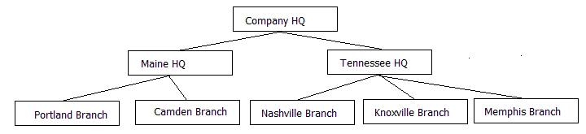
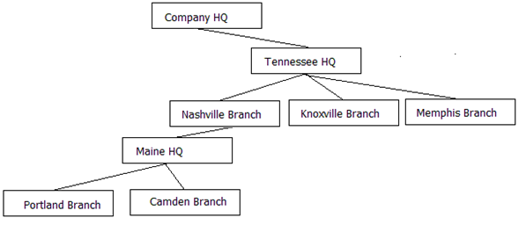
Reparenting Example
Starting with:
Perhaps ending with:

Slide 16
Coding for trees
Basic Manipulation:
Creating a new node
Moving/Reparenting a node
Deleting a node
Processing
Getting the children of a node
Getting the parent of a node
Aggregating along the tree

Slide 17
Aggregating along the Tree
$500
$200
$300
$100
$100
$100
$100
$100

Slide 18
Coding for trees
Basic Manipulation:
Creating a new node
Moving/Reparenting a node
Deleting a node
Processing
Getting the children of a node
Getting the parent of a node
Aggregating along the tree
Note: most tree algorithms do not allow for “simple” SQL solutions to all of these needs

Slide 19
Tree Processing Algorithms
There are several methods for processing trees in SQL
Fixed Levels – Limiting tree to a fixed depth
Adjacency List – Basically depth first implemented in one of a number of ways
Path Technique – Defining the path of the tree in a string (very much like a DOS path in structure)
HierarchyId – Using the built-in CLR type to implement the hieararchy
Nested Sets – Uses positions in the tree to enhance read performance
Kimball Helper Table – Storing all positions in tree to reduce processing to simple query
Today I will demo the code for the Adjacency List. Code available for all of these on my website presentation downloads.

Slide 20
Implementing a tree – Fixed Levels
Use when your hierarchy needs can be limited to exactly the same levels for all branches
Built in a separate structure by definition when used in an OLTP database
Usage
Maintenance: Very easy with simple SQL commands. Care needed to make sure structures don’t end up with cycles by repeating companies in different levels
Reading data: Queries are very simple, needing only simple joins to limit data to given ranges/levels
CREATE TABLE CompanyHierarchy ( OwningCompanyId int NOT NULL FK to Company…, HeadquartersCompanyId int NOT NULL FK to Company …, BranchCompanyId int NOT NULL FK to Company … PRIMARY KEY (Company, Headquarters, Branch) );

Slide 21
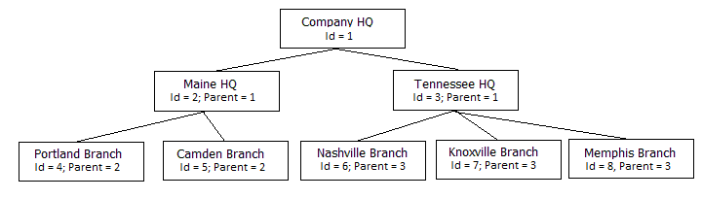
Implementing a tree – Adjacency List
Every row includes the key value of the parent in the row
Parent-less rows are considered root nodes
Usage
Maintenance: Very easy with simple SQL commands. Structure is resilient to change
Reading data: Code to fetch rows is the most complex to write (though not as inefficient as it seems)
CREATE TABLE Company ( CompanyId int NULL PRIMARY KEY, ParentCompanyId int NULL FK Company (CompanyId) Name nvarchar(100) NOT NULL, Etc.. );

Slide 22
Adjacency List -Variations on a Theme
Two simple one parent “trees”
(Getting closer to a developer reporting hierarchy
Simple one parent “tree”
Simple One Parent Tree in External Structure
Graph, allowing Employee to have multiple reports but only one for a Relationship Type
Graph, allowing Employee to have multiple people they report to for the same reason (REALITY!)

Slide 23
Implementing a tree – Adjacency List
Every row includes the key value of the parent in the row
Parent-less rows are considered root nodes
Usage
Maintenance: Very easy with simple SQL commands. Structure is resilient to change
Reading data: Code to fetch rows is the most complex to write (though not as inefficient as it seems)
CREATE TABLE Company ( CompanyId int NULL PRIMARY KEY, ParentCompanyId int NULL FK Company (CompanyId) Name nvarchar(100) NOT NULL, Etc.. );

Slide 24
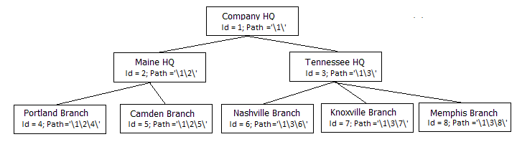
Implementing a tree – Path Method
Every row includes a representation of the path to their parent
Usage
Maintenance: Data in paths must be managed carefully. Limitation on path size for string manipulation/indexing.
Reading data: Code to fetch rows is based on string manipulation using LIKE operator, and other string manipulation.
CREATE TABLE Company ( CompanyId int NOT NULL PRIMARY KEY, Name nvarchar(100) NOT NULL UNIQUE, Path varchar(1700) UNIQUE );

Slide 25
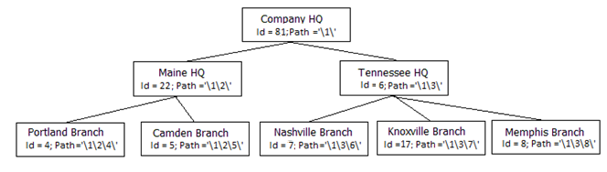
Implementing a tree – HierarchyId
Uses a built in datatype to manage the hierarchy. Seems similar to Path, but uses position in path, instead of using the path as a LIKE condition.
Usage
Maintenance: Data in paths must be managed carefully. Has some limitations that are similar to the Path Method when moving around nodes. hierarchyId methods are pretty unnatural, and can be complex to work with.
Reading data: hierarchyId methods exist to get children and parents of nodes easily. Breadth-first processing is built in as a pattern of usage
CREATE TABLE Company ( CompanyId int NOT NULL PRIMARY KEY, Name nvarchar(100) NOT NULL, OrgNode hierarchyId NOT NULL, OrganizationLevel AS OrgNode.GetLevel() );

Slide 26
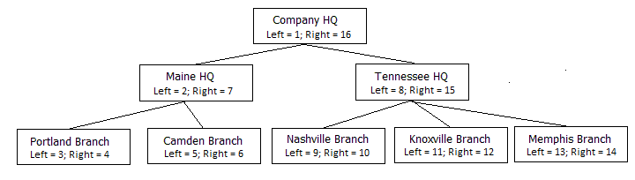
Implementing a tree – Nested Sets
Uses positions of nodes and numbers to fetch children and parents
Usage
Maintenance: Modifying the structure (adding and removing nodes) is a very costly operation, and can cost many times more than any other method. Using a gapped implementation, leaving space for new nodes can greatly enhance performance. (A version of this in included in the downloads)
Reading data: Query processing is done using easily optimized range queries. Generally is the fastest method to work with large tree structures.
CREATE TABLE Company ( CompanyId int NOT NULL PRIMARY KEY, Name nvarchar(100) NOT NULL, Left int NOT NULL, Right int NOT NULL );

Slide 27
Implementing a tree – Nested Sets
Uses positions of nodes and numbers to fetch children and parents
Usage
Maintenance: Modifying the structure (adding and removing nodes) is a very costly operation, and can cost many times more than any other method. Using a gapped implementation, leaving space for new nodes can greatly enhance performance. (A version of this in included in the downloads)
Reading data: Query processing is done using easily optimized range queries. Generally is the fastest method to work with large tree structures.
CREATE TABLE Company ( CompanyId int NOT NULL PRIMARY KEY, Name nvarchar(100) NOT NULL, Left int NOT NULL, Right int NOT NULL );

Slide 28
Implementing a tree – Kimball Helper
Basically explodes the hierarchy into a table that turns all hierarchy manipulations into a relational query
Developed by Ralph Kimball and team for reporting on data in a hierarchy.
Usage
Maintenance: Maintenance can be slightly costly, but using the data is extremely fast. Processing time is generally less than expected
Reading data: Extremely fast, because all processing is simply based on standard SQL JOIN operations.
CREATE TABLE CompanyHierarchyHelper ( ParentCompanyId int NOT NULL, ChildCompanyId int NOT NULL, Distance int NOT NULL, ParentRootNodeFlag bit NOT NULL, ChildLeafNodeFlag bit NOT NULL, PRIMARY KEY (ParentCompanyId, ChildCompanyId) );

Slide 29
Implementing a tree – Kimball Helper
The rows in yellow expand to the table shown:
ParentId | ChildId | Distance | ParentRootNodeFlag | ChildLeafNodeFlag
1 | 1 | 0 | 1 | 0
1 | 2 | 1 | 1 | 0
1 | 4 | 2 | 1 | 1
1 | 5 | 2 | 1 | 1
2 | 2 | 0 | 0 | 0
2 | 4 | 1 | 0 | 1
2 | 5 | 1 | 0 | 1
4 | 4 | 0 | 0 | 1
5 | 5 | 0 | 0 | 1

Slide 30
Implementing a tree – Kimball Helper
Basically explodes the hierarchy into a table that turns all hierarchy manipulations into a relational query
Developed by Ralph Kimball and team for reporting on data in a hierarchy.
Usage
Maintenance: Maintenance can be slightly costly, but using the data is extremely fast. Processing time is generally less than expected
Reading data: Extremely fast, because all processing is simply based on standard SQL JOIN operations.
CREATE TABLE CompanyHierarchyHelper ( ParentCompanyId int NOT NULL, ChildCompanyId int NOT NULL, Distance int NOT NULL, ParentRootNodeFlag bit NOT NULL, ChildLeafNodeFlag bit NOT NULL, PRIMARY KEY (ParentCompanyId, ChildCompanyId) );

Slide 31
Demo Setup
For the Adjacency List method*, we will see how to:
Implement a physical model that models the corporate hierarchy of the previous graphics
Create Stored Procedures for Insert, Reparent, Delete
Queries to access and aggregate the data in the hierarchy
We will do this for two sets of data, the data in the presentation, and then a randomly generated set.
*Adjacency List is a foundational need for processing graph structures as well. Similar code is available for all methods

Slide 32
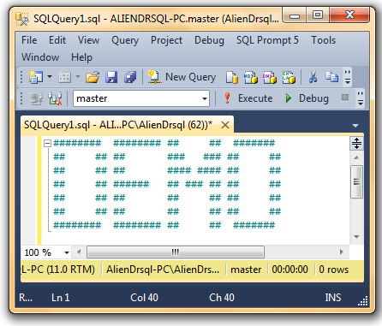
Demo Code
Example, usable code for each type available in download
In each case I implement the insert, delete and reparent operations in a stored procedure

Slide 33
Graphs
Generally can be handled in same manner as tree adjacency list
Primary difference is by definition, child can have > 1 parent node
Cycles are acceptable in certain implementations
Algorithm is tweaked to stop on a detected cycle
Graph structure will always be external to data structure
Graphs are even more natural data structures than trees

Slide 34
Our Example
People Connected to One Another
Interest
Person
People’s Interests

Slide 35
Graphs
We will look at two implementations
Using relational tables
Using SQL Graph tables in SQL Server 2017
As of SQL Server 2017, the way you use them is very similar due to several limitations.

Slide 36
Using a Relational Table
Classic many to many relationships pattern is used
--Node CREATE TABLE Social.Person ( PersonId int IDENTITY(1, 1) PRIMARY KEY, UserName nvarchar(30) NOT NULL UNIQUE, );
--Edge CREATE TABLE Social.PersonConnection ( PersonId int NOT NULL REFERENCES Social.Person(PersonId), ConnectedToPersonId int NOT NULL REFERENCES Social.Person (PersonId), PRIMARY KEY ( PersonId, ConnectedToPersonId), CHECK(PersonId <> ConnectedToPersonId) );

Slide 37
Using Graph Tables
Uses new syntax that declares the table as a Node or an Edge
Node must have user-defined columns, Edges can, but not required
Edge relationships are directed (N1 related to N2, does not imply N2 related to N1)
CREATE TABLE SocialGraph.Person ( UserName nvarchar(30) UNIQUE ) AS NODE; CREATE TABLE SocialGraph.ConnectedTo AS EDGE;
Person will have a psuedocolumn $node_id added
ConnectedTo will have 3 pseudocolumns: $edge_id, $from_id, $to_id
(The physical table’s columns have a hex value appended)

Slide 38
Graph Table Usage
Node1 related to Node2 through Edge
SELECT .. FROM Node, Edge, Node2 WHERE MATCH(Node-(Edge)->Node2)
Node1 related to Node3 (where Node1 is related to Node2, and Node2 is related to Node3)
SELECT .. FROM Node, Edge, Node2, Edge2, Node3 WHERE MATCH(Node-(Edge)->Node2-(Edge2)->Node3)
Node1 and Node3 are both connected to Node2
SELECT .. FROM Node, Edge, Node2, Edge2, Node3 WHERE MATCH(Node-(Edge)->Node2<-(Edge2)-Node3)

Slide 39
Graph Table Syntax Current Limitations
Edges cannot be reused, Nodes can
SELECT .. FROM Node, Edge, Node2 WHERE MATCH(Node-(Edge)->Node2) AND MATCH(Node<-(Edge)-Node2)
Cannot use a node in a JOIN in the FROM clause and in a MATCH (can inner join in WHERE clause)
SELECT .. FROM Node JOIN Table On Table.TableId = Node.TableId, Edge, Node2, Edge2, Node3 WHERE MATCH(Node-(Edge)->Node2-(Edge2)->Node3)
It is possible to JOIN the Node and Edge using JOIN
SELECT .. FROM Node JOIN Edge On Node.$node_id = Edge.$from_id
Cannot use MATCH with OR, or NOT
Cannot update an Edge’s From or To Nodes (can update relational columns)

Slide 40
Demo Code
For more good info, this blog by Dennes Torres is really good:
https://www.red-gate.com/simple-talk/sql/t-sql-programming/sql-graph-objects-sql-server-2017-good-bad/

Slide 41
Contact info
Louis Davidson - louis@drsql.org
Website – http://drsql.org <-- Get any/updated slides here
Twitter – http://twitter.com/drsql
Simple Talk Blog https://www.red-gate.com/simple-talk/author/louis-davidson/

